Slide 1
Light Show
Mission 3

Slide 2

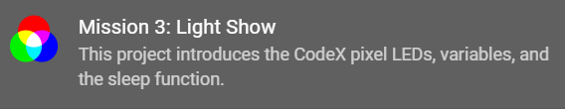
Pre-Mission Preparation
In the Mission 3 log, answer the pre-mission preparation questions:
What are primary colors?

Slide 3
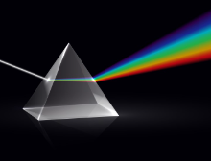

Pre-Mission Activity
The CodeX has 10 LEDs (little lights). Four of the lights are Smart RGB LEDs -- also called pixel LEDs.
What is a Smart RGB LED (pixel LED)?
With only three colors -- red, green and blue -- the LED can display any color
Click on to add it to your toolbox.

Slide 4

What are pixels and how do they work?
By Xavier Galdur

Slide 5
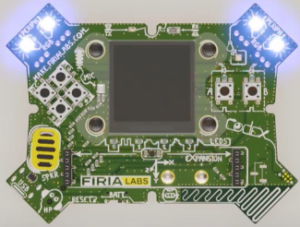
Objective #1: Find the pixels
The CodeX has four Red, Green, Blue (RGB) LEDs along the top edge.
These are the Smart LEDs
Also called pixel LEDs
You can set these LEDs to any color under the sun.

Slide 6
Objective #1: Find the pixels
The CodeX library gives you some colors to use:
BLACK (same as off)
BROWN
RED
ORANGE
YELLOW
GREEN
BLUE
PURPLE
GRAY
WHITE
CYAN
MAGENTA
PINK
LIGHT_GRAY
DARK_GREEN
DARK_BLUE

Slide 7
Mission Activity #1
DO THIS:
Close the instruction panel
Use the camera controls to rotate the CodeX
Click on pixel 0 (the first RGB LED)

Slide 8
Mission Activity #1
DO THIS:
Create a new file named Pixels1
Click the File menu button
Select “New File…”
Name the file Pixels1
  no spaces in a file name
Click Create

Slide 9

Objective #2: Turn on the red light
In Python, use the function:
pixels.set(number, color)
to turn on a pixel LED
The function takes two inputs, called arguments
First argument
The number of the smart LED (or pixel)
Second argument
The color to display

Slide 10
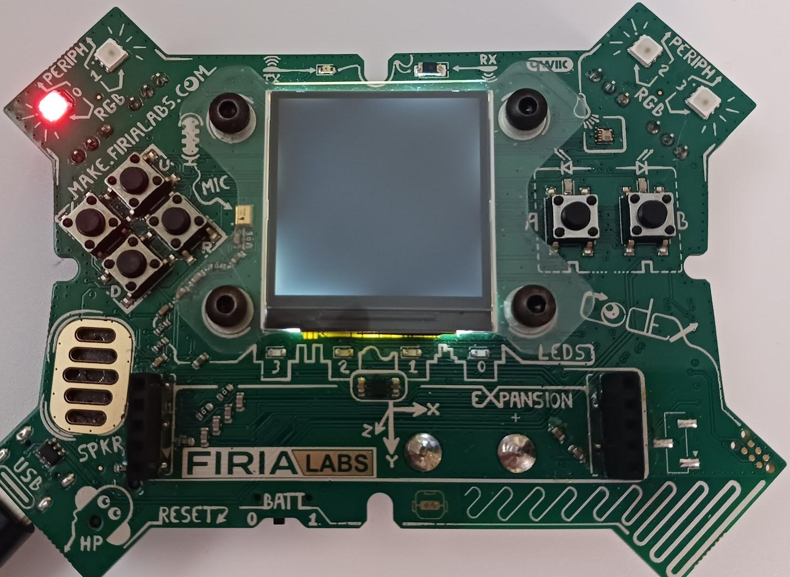
Mission Activity #2
DO THIS:
Click on CodeTrek
Type the code into your new file
Run the code
Change the code to display a different color

Slide 11
Objective #3: Two in a row
Now display two colors in sequence
Sequence means “go in order, one line at a time”
But computers are very fast!

Slide 12
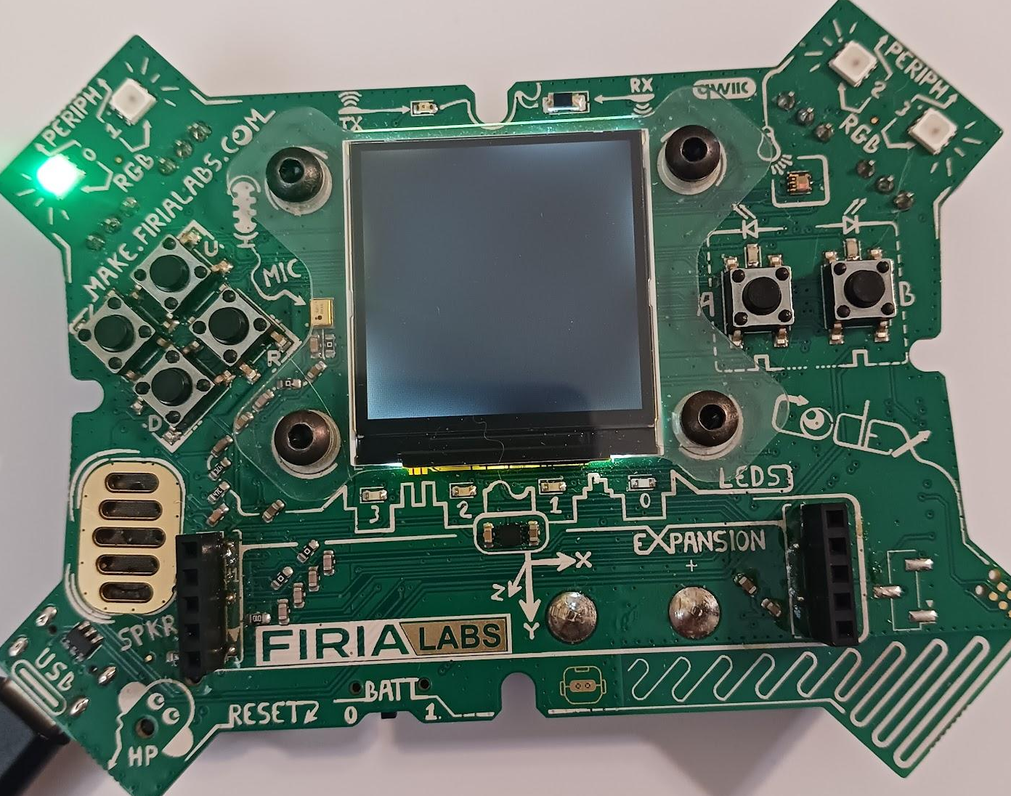
Mission Activity #3
Using only pixel 0, turn it RED and then GREEN
DO THIS:
The Pixels1 code already turns pixel 0 to RED
Add another line of code (line 3) that will turn pixel 0 to GREEN
Did you see both colors?

Slide 13
Objective #4: What’s going on?
Why is only the last color showing?
Did you notice the program ends very quickly?
It doesn’t wait for you to see the first color before it displays the second color
And the last color stays on even after the program ends

Slide 14
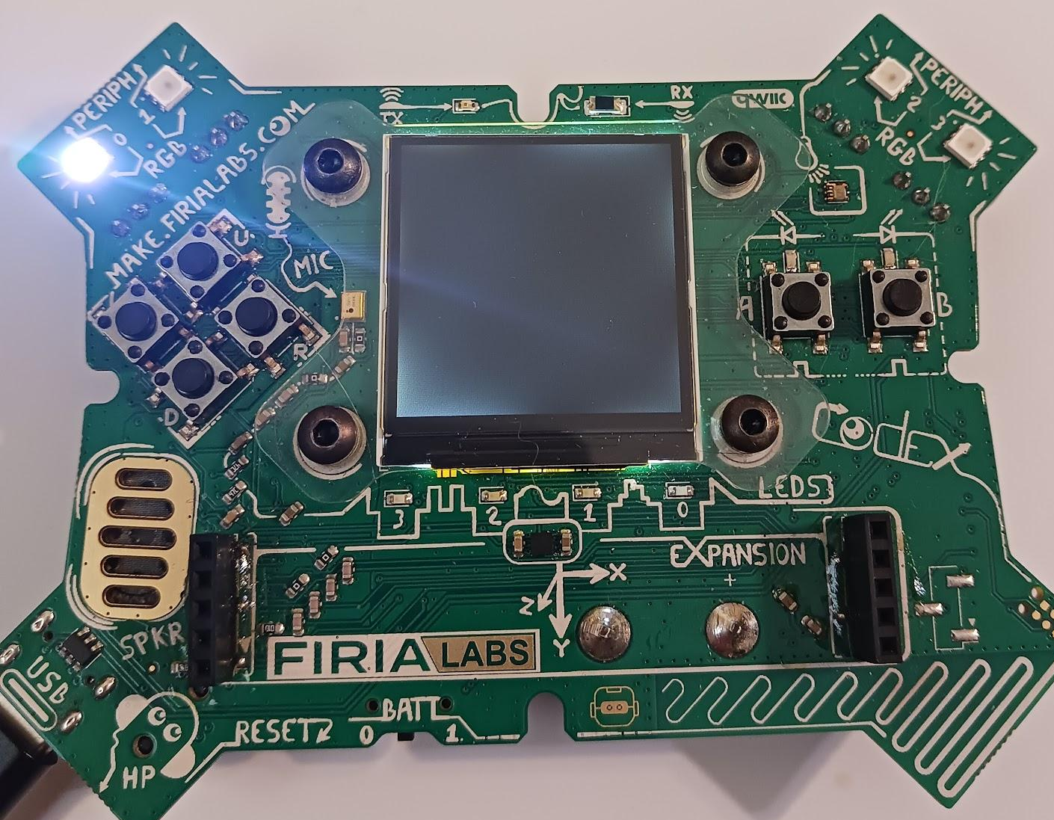
Mission Activity #4
Add more colors to your code. Using only pixel 0, change it to four different colors.
DO THIS:
Add two more lines of code to Pixels1
Line 4 -- change to BLUE
Line 5 -- change to WHITE
Before you run your code, predict what will happen.
Write your prediction in the Mission Log
Run your code

Slide 15

Two images quiz
From the last two objectives, you have learned about sequential coding and the speed of the CPU.
Answer the quiz question
CODEX
QUIZ

Slide 16

Objective #5: Find the bug
Inside the mind of a computer
Computers are fast. Even a small computer like the CodeX can execute millions of operations per second!
CodeSpace includes an important tool called the “debugger”. It slows down the program execution and lets you see the code running sequentially -- one line at a time.

Slide 17


Mission Activity #5
DO THIS:
Click on to add it to your toolbox
Write the definition of ‘bug’ in your Mission Log
Watch the debug video in the instruction panel
Answer the question in your Mission Log
Click on debug button

Slide 18

Objective #6: Step by step colors
Your turn to use the debugger
You can execute, or run, one line at a time using the
“Step In” button, which is part of the debugger.
Remember: The code is run AFTER the line is highlighted.
Continue
Step In
Restart
Step Over
Step Out
Stop

Slide 19

Mission Activity #6
Try stepping through your code
DO THIS:
Click the debug icon
Click the Step In icon
Slowly click the Step In icon several more times, observing what happens after each click
Now do you see all four colors?

Slide 20
Objective #7: Slow it down
When you step slowly through the code, all the colors show up.
You just need a way to delay the computer a little after it shows each color
The time module has a sleep() function that will pause program execution
sleep(1) will delay (or pause) the program for 1 second
One argument:
# of seconds

Slide 21

Mission Activity #7
Update your code
DO THIS:
Click on to add it to your toolbox
Open CodeTrek
Change your code to look like the code in CodeTrek
Remember: type the actual sleep(1) command for line 9, not the #TODO comment
Run your code

Slide 22
Objective #8: Name that number
It would be fun to play with some different delay times.
Right now the number 1 appears three times in the code
If you want to change the pause shorter or longer, you would need to change 1 three times
This number is called a ‘literal’

Slide 23
Objective #8: Name that number
Instead of repeating a literal number like 1 in your code, you can use a name instead.
A variable is a name you can give to data
Data can be a number, a color, an image, or even words (called strings)
The variable name describes the data
A variable is defined before it is used in code

Slide 24
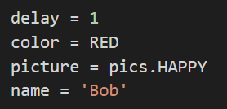
Objective #8: Name that number
Once a variable is defined, it can be used instead of a literal. Then if you want to change the value, you only have to change it once.
Examples of defining variables:

Slide 25
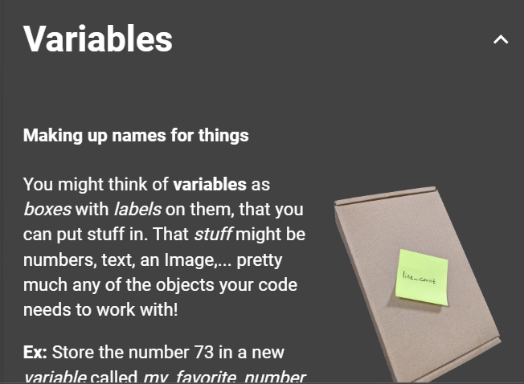

Mission Activity #8
Learn more about variables
DO THIS:
Click on to add it to your toolbox
Answer the Mission Log questions

Slide 26
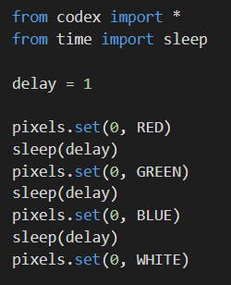
Mission Activity #8
Update your code
DO THIS:
Open CodeTrek and use it to help you modify your code
Define a variable called delay
Use delay in the sleep() functions
Run your code
Did you see all four colors?

Slide 27
Variables quiz
Objective #8 introduced variables. See what you learned in this quiz.
Answer the two quiz questions
Read the questions carefully -- they can be tricky!
CODEX
QUIZ

Slide 28
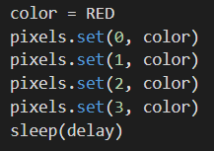
Objective #9: Warning sign
Time to light up all four pixel LEDs
You can use pixels.set() to light up all four pixels
Just change the argument for the pixel number
You can use a variable for the color argument

Slide 29
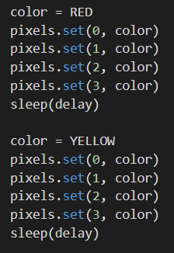
Objective #9: Warning sign
Time to light up all four pixel LEDs
You can change the value of a variable any time in the code
This example shows changing the value of color
You can also change the value of delay if you want to

Slide 30
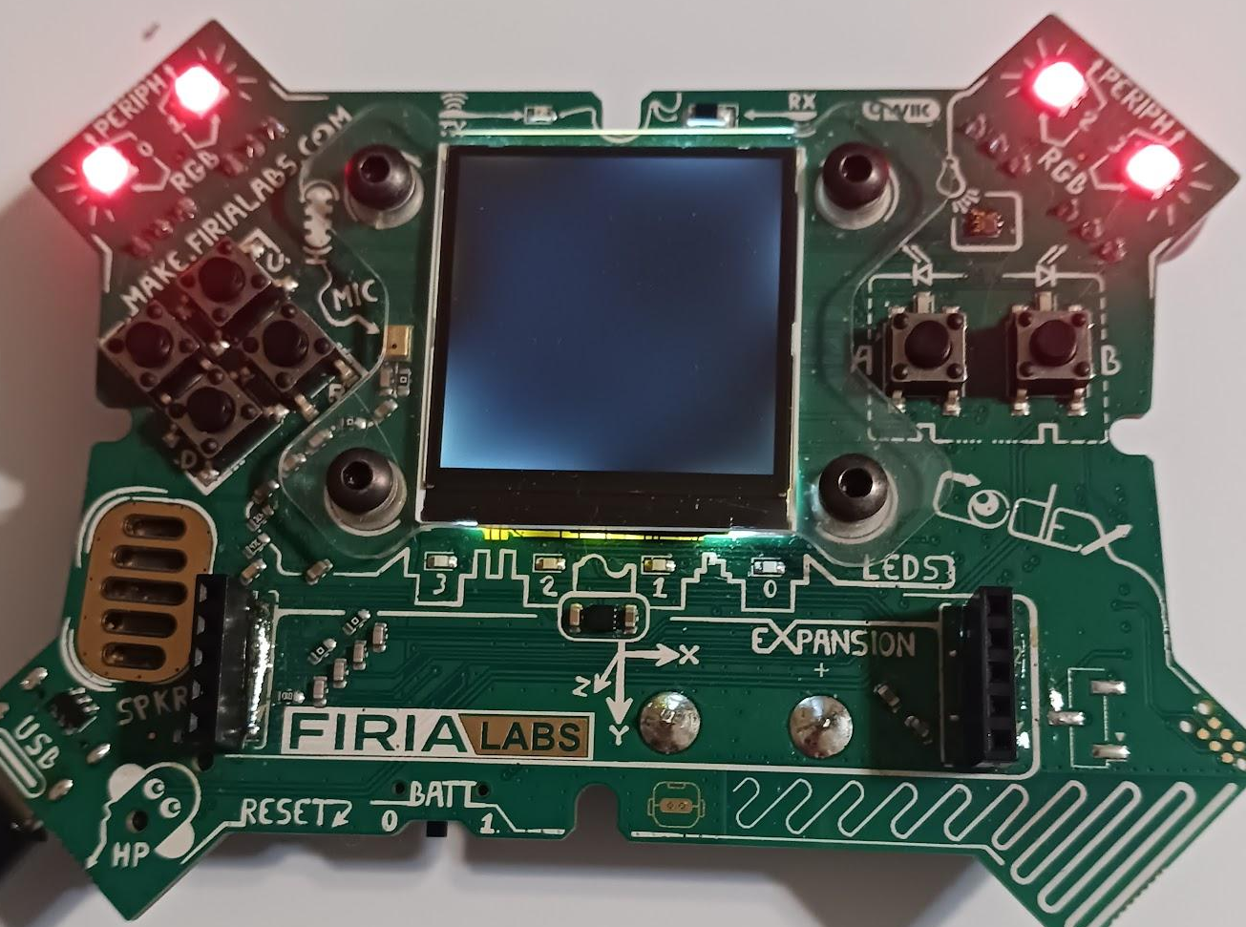
Mission Activity #9
DO THIS:
Create a second variable for color
Set the color to RED
Use the color variable in pixels.set() to turn all four pixels the same color
Change the color and turn all four pixels a second color
Use CodeTrek if you need help
Run your code
Optional: repeat the code between RED and YELLOW again to make a flashing warning sign

Slide 31
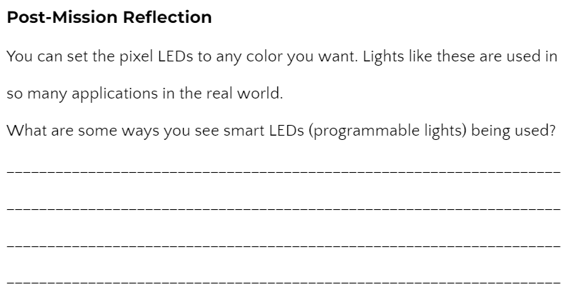
Post-Mission Reflection
Read the “completed mission” message and click to complete the mission
Complete the Mission 3 Log

Slide 32
Clearing your CodeX

Slide 33
The need for clearing CodeX
Every time you run your program, it is loaded onto the CodeX
The last program run stays on the CodeX, even after it is unplugged from the computer
So you want the last program run to be something that clears the CodeX and isn’t an assignment

Slide 34
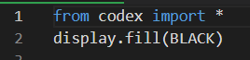
Create a file “Clear”
Create a new file called Clear
Type these two lines of code:
Run the code
  The CodeX should be blank, with no pictures or lights on
Run this code at the end of every class period

